Slide 1
CMSC201 Computer Science I for Majors Lecture 23 – Searching and Sorting

Slide 2
Last Class We Covered
Data representation
Binary numbers
Floating point errors
ASCII values
Short circuit evaluation
#TBT
Boolean Expressions

Slide 3
Any Questions from Last Time?

Slide 4
Today’s Objectives
To learn about some sorting algorithms
Selection Sort
Bubble Sort
Quicksort
To learn more about searching algorithms
Linear search
Binary search

Slide 5
Sorting

Slide 6
Sorting Algorithms
Sorting algorithms put the elements of a list in a specific order
A sorted list is necessary to be able to use certain other algorithms
Like binary search!
If a list is sorted once, we can quickly search it many, many times

Slide 7
Sorting Algorithms
There are many different ways to sort a list
What method would you use?
Now imagine you can only look at at most two elements at a time
What method would you use now?
Computer science has a number of commonly used sorting algorithms

Slide 8
Bubble Sort

Slide 9
Bubble Sort Algorithm
Let’s take a look at a common sorting method!
We look at the first pair of items in the list, and if the first one is bigger than the second one, we swap them
Then we look at the second and third one and put them in order, and so on
Once we hit the end of the list, we start over at the beginning
Repeat until the list is sorted!

Slide 10
Bubble Sort Example
[ 4, 8, 1, 10, 13, 14, 6]
First pass:
4 and 8 are in order
8 and 1 should be swapped:
[ 4, 1, 8, 10, 13, 14, 6]
8 and 10 are in order
10 and 13 are in order
13 and 14 are in order
6 and 14 should be swapped:
[ 4, 1, 8, 10, 13, 6, 14]

Slide 11
Bubble Sort Example (Cont)
[ 4, 1, 8, 10, 13, 6, 14]
Second pass:
4 and 1 should be swapped:
[ 1, 4, 8, 10, 13, 6, 14]
4 and 8 are in order
8 and 10 are in order
10 and 13 are in order
13 and 6 should be swapped:
[ 1, 4, 8, 10, 6, 13, 14]
13 and 14 are in order

Slide 12
Bubble Sort Example (Cont)
[ 1, 4, 8, 10, 6, 13, 14]
Third pass:
10 and 6 should be swapped:
[ 1, 4, 8, 6, 10, 13, 14]
Fourth pass:
8 and 6 should be swapped:
[ 1, 4, 6, 8, 10, 13, 14]

Slide 13
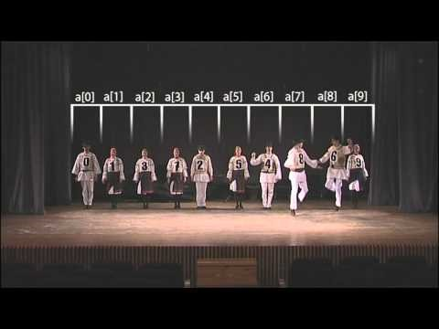
Bubble Sort Video
Video from https://www.youtube.com/watch?v=lyZQPjUT5B4

Slide 14
Selection Sort

Slide 15
Selection Sort Algorithm
Here is a very simple way of sorting a list:
Find the smallest number in a list
Move that to the end of a new list
Repeat until the original list is empty
Unfortunately, it’s also pretty slow!

Slide 16
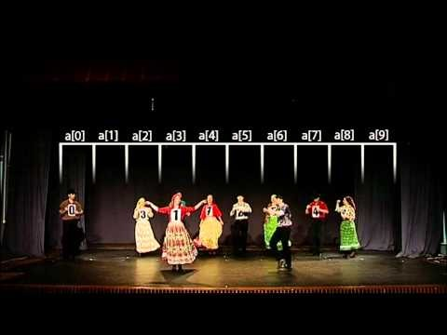
Selection Sort Video
Video from https://www.youtube.com/watch?v=Ns4TPTC8whw

Slide 17
Quicksort

Slide 18
Quicksort Algorithm
Here’s one more method:
Start with the number on the far right
Put everything less than that number on the left of it and everything greater than it on the right of it
Quicksort the left side and the right side
Does this method remind you of anything?

Slide 19
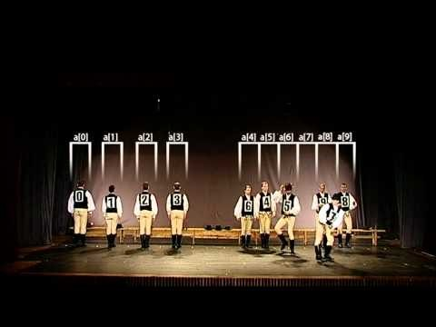
Quicksort Video
Video from https://www.youtube.com/watch?v=ywWBy6J5gz8

Slide 20
Search

Slide 21
Motivations for Searching
Want to know if something exists
Python can do this for us!
Want to know where something exists
Python can actually do this for us too!
raceWinners.index("#718")
But how does Python does this?

Slide 22
Exercise: find()
Write a function that takes a list and a variable and returns the index of the variable in the list
If it’s not found, return -1
You can’t use index()!
def find(searchList, var)

Slide 23
Exercise: find() Solution
def find(searchList, var):
for i in range(len(searchList)):
if searchList[i] == var:
return i
# outside the loop, means that
# we didn't find the variable
return -1

Slide 24
Linear Search
You just programmed up a search function!
This algorithm is called linear search
It’s a common, fundamental algorithm in CS
It’s especially useful when our information isn’t in a sorted order
But it isn’t very fast

Slide 25
Searching Sorted Information
Now, imagine we’re looking for information in something sorted, like a phone book
We know someone’s name (it’s our “variable”), and want to find their number in the book
What is a good method for locating their phone number?
Think about how a person would do this

Slide 26
Algorithm in English
Open the book midway through.
If the person’s name is on the page you opened to
You’re done!
If the person’s name is after the page you opened to
Tear the book in half, throw the first half away and repeat this process on the second half
If the person’s name is before the page you opened to
Tear the book in half, throw the second half away and repeat this process on the first half
This is rough on the phone book, but you’ll find the name!

Slide 27
Binary Search

Slide 28
Binary Search
The algorithm we just demonstrated is better known as binary search
We talked about it previously, remember?
Binary search is only usable on sorted lists
Why?

Slide 29
Solving Binary Search
Binary search is a problem that can be broken down into
Something simple (breaking a list in half)
A smaller version of the original problem (searching that half of the list)
That means we can use ...
recursion!

Slide 30
Exercise: Recursive Binary Search
Write a recursive binary search!
To make the problem slightly easier, make it “checking to see if something is in a sorted list”
If there’s no “middle” of the list, we’ll just look at the lower of the two “middle” indexes

Slide 31
Exercise: Recursive Binary Search
Write a recursive binary search!
Remember to ask yourself:
What is our base case(s)?
What is the recursive step?
def binarySearch(myList, item):
A hint: in order to get the number at the middle of the list, use this bit of code: myList[len(myList) // 2]

Slide 32
Time for…
LIVECODING!!!

Slide 33
Announcements
Final is when?
Project 3 out now
Design due on Friday, May 5th @ 8:59:59 PM
Project due on Friday, May 12th @ 8:59:59 PM
You have two weeks to do the project!
Survey #3 also out – follow link in announcement
Friday, May 19th from 6 to 8 PM

